Slide 1
SC1015 Mini-Project:
Cricket Match Outcome Predictor

Slide 2
Our motivation

Slide 3

Passion for cricket
Popularity of IPL
Fantasy League
Curiosity about application of ML for predicting sporting events
Notes:
IPL is the biggest and most popular competitive international cricket league in the world.

Slide 4
Cricket 101

Slide 5
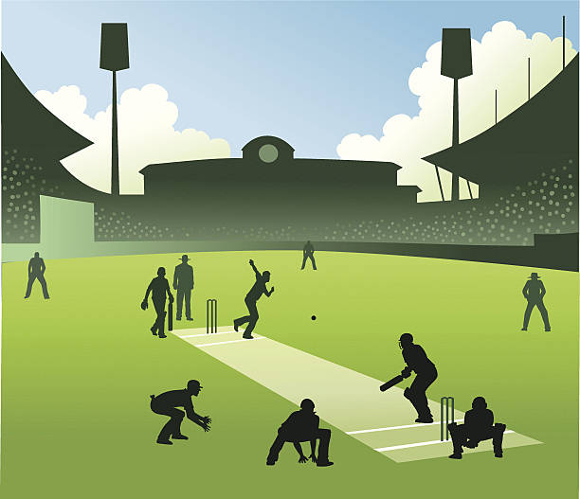
Game played between 2 teams of 11 players each
One team bats and the other bowls once in every game. Each instance of batting and bowling is called an inning.

Slide 6

The batting team has 10 wickets when the game starts. The inning ends when 10 batsmen are eliminated or the number of overs are completed.
The batting team’s aim is to maximise the number of runs they score, while the bowling team aims to minimise the batting team’s score.

Slide 7
The Dataset

Slide 8

IPL Complete Dataset (2008-2020)
Retrieved from https://www.kaggle.com/datasets/patrickb1912/ipl-complete-dataset-20082020
The dataset contains two separate CSV files: matches and deliveries, which contain a summary of the matches and ball by ball data of the matches respectively.
The data was originally sourced from cricsheet.

Slide 9
Problem Definition
Predicting the outcome of the cricket match, ie., the winner of the match based on data from 75% of the data from the match.

Slide 10
Our Approach

Slide 11
Our approach is to use data from 75% of each inning for every match to predict final match outcome.
We used two different supervised ML algorithms — Classification and Regression
Compared the two algorithms, to see which is better suited for predicting the match outcome

Slide 12
Data preparation

Slide 13
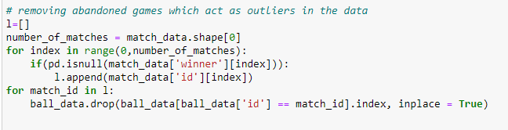
Cleaning the dataset
Removed incomplete matches (matches ended due to rain, etc)

Slide 14
The Predictor Variables
The five variables we used for prediction(data from the 75% mark of each inning in a match) are:
Weighted Average Economy of the best bowlers with overs left (Number of runs conceded by bowler per over bowled)
Team score (Sum of runs scored by the team off the bat and extras)
Wickets left
Average Strike rate of the batsmen (The average number of runs scored by a batsman per 100 balls faced)
Average runs scored by the batsmen who are still batting
Notes:
Economy: Number of runs conceded by bowler per over bowled
Team score: Sum of runs scored by the team off the bat and extras
Batting strike rate: The average number of runs scored by a batsman per 100 balls faced

Slide 15
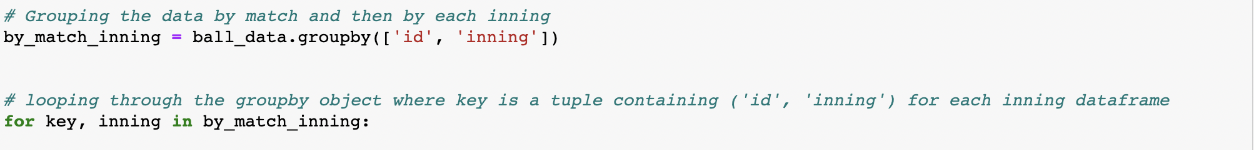
Removed the final 25% of the inning and appended each team’s final score to the dataframe.
Grouped by id and inning and iterated through the groupby object to isolate for each inning
For each inning:
Summed up is_wicket and total_score columns to find wickets_left and team_score
Added the response variable final_score
Further grouped by bowler to calculate weighted economy
Iterated through the inning ball by ball to calculate average runs scored and average strike rate

Slide 16
Tools and Techniques
Made use of techniques learned in the course:
Iterating through Dataframe; adding, dropping columns based on conditions
Resetting index, sorting values, and removing null values
Learned new techniques to handle data:
Used Pandas.DataFrame.groupby()
Concatenation to recombine groupby data
Sum, Cumulative sum
Notes:
df.groupby() splits the dataframe by a particular attribute and return a groupby object which stores the various grouped Data frames according to the attribute, which is the ‘key’. Grouped by match, inning, used it to find inning data as well as batsman data. Then grouped by bowler and over for each inning to retrieve bowler data.

Slide 17
04
Insights from the dataset

Slide 18
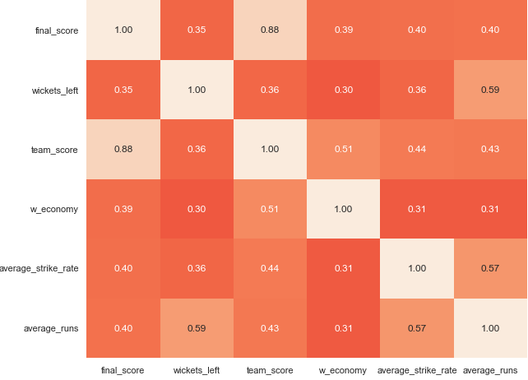
team_score was the variable with highest correlation with the response final_score. The other four variables had similar correlation values close to 0.4.
Correlation matrix of the created variables including the response variable

Slide 19
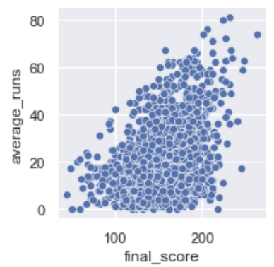
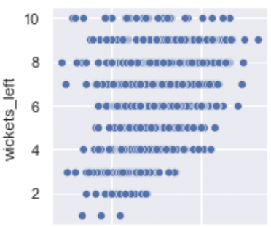
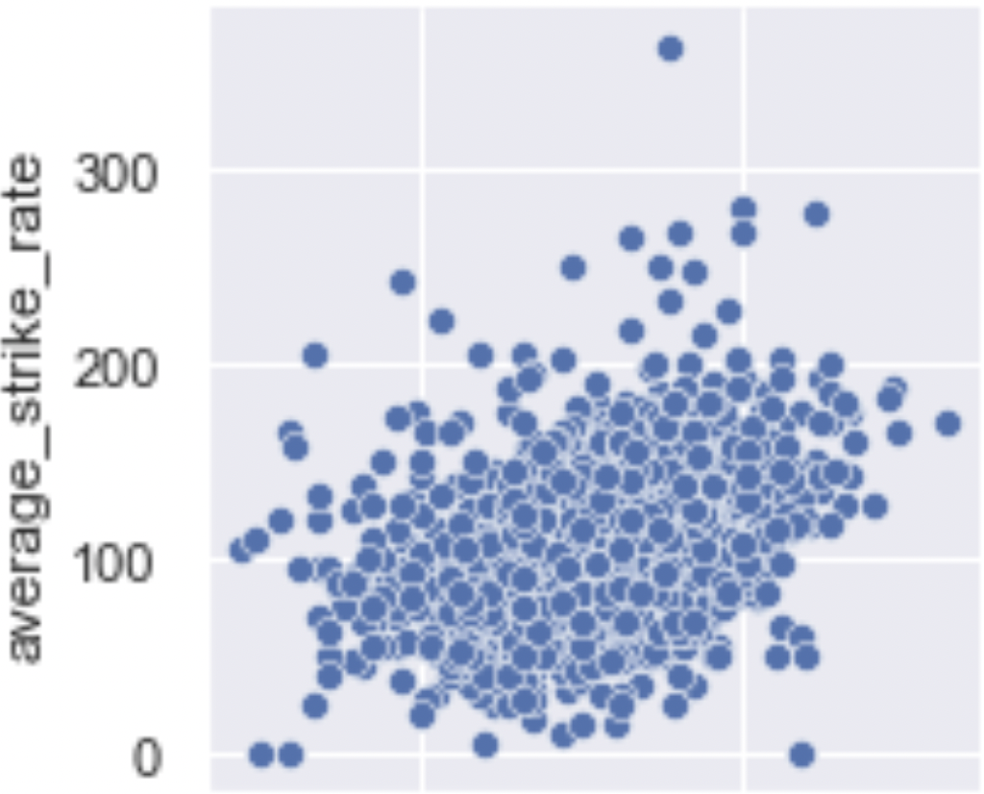

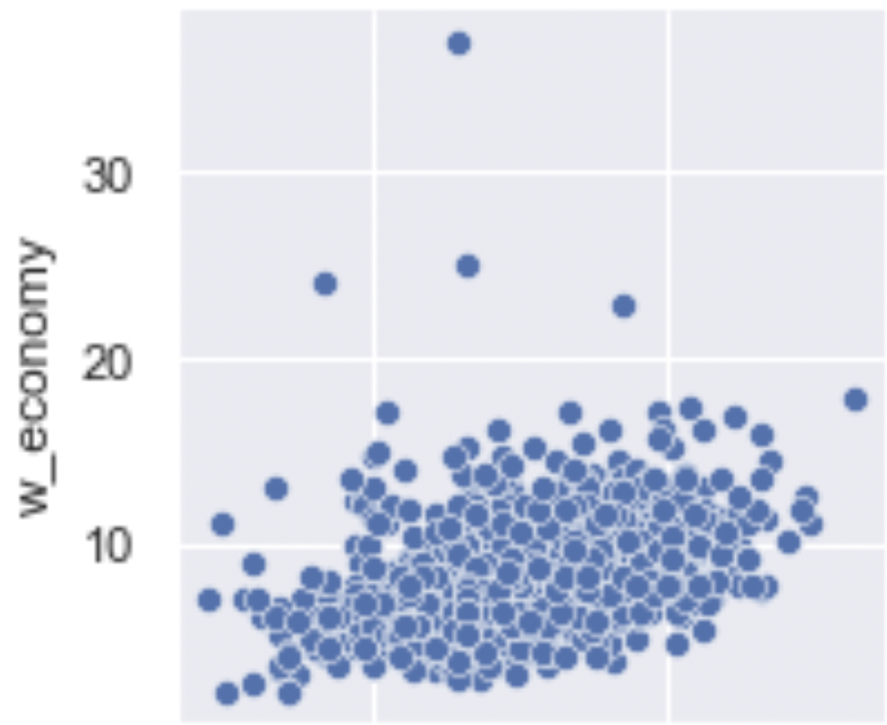
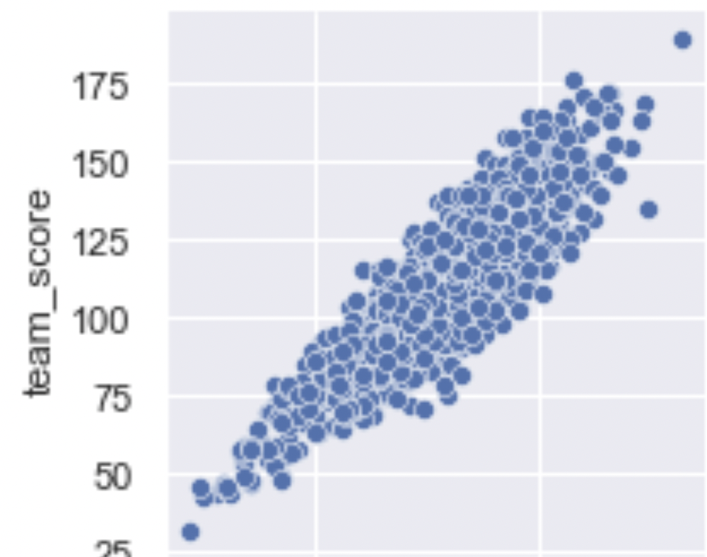
Joint-plots with Predictors vs Response

Slide 20
Machine Learning Models:
Linear Regression
Classification

Slide 21
Linear Regression

Slide 22


Multivariate linear Regression
We used a 75:25 random train-test split to train our model
We obtain the coefficients for the predictor variables for a linear equation by using Scikit Learn’s Multivariate regression.
The equation gives the value of total run scored by a team at the end of the inning. The team with the higher score is the match winner.

Slide 23
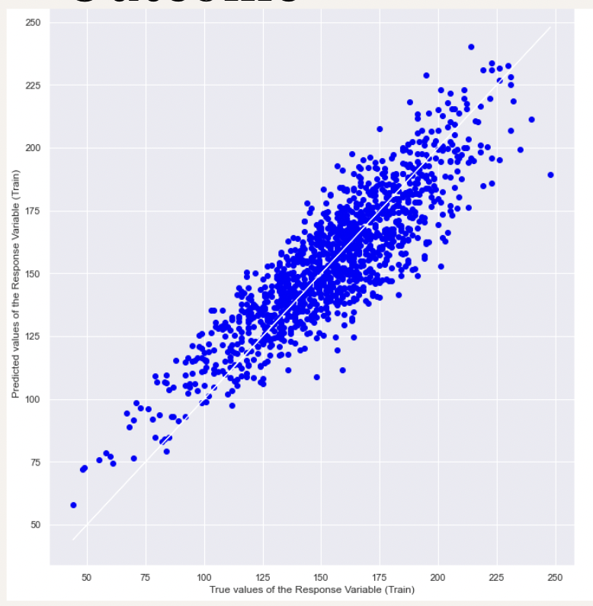
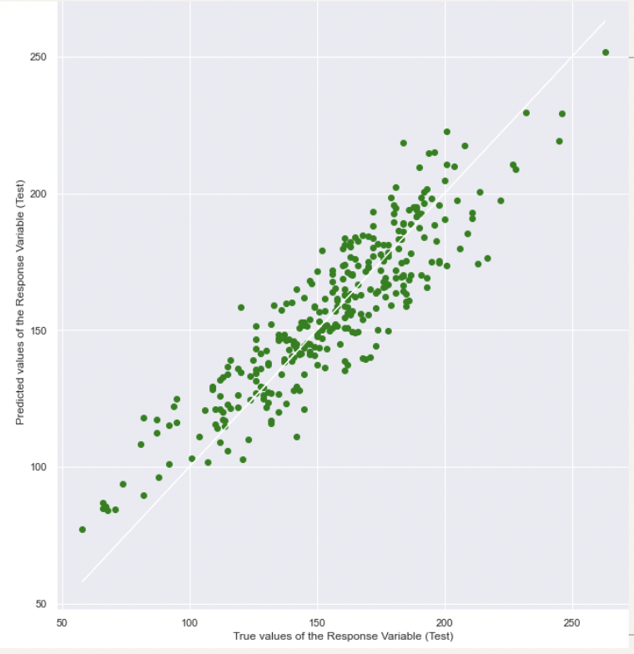
Outcome
Test data:
Explained variance: 0.811
Mean Squared Error: 206.5
Accuracy: 73.45%

Slide 24
Classification

Slide 25
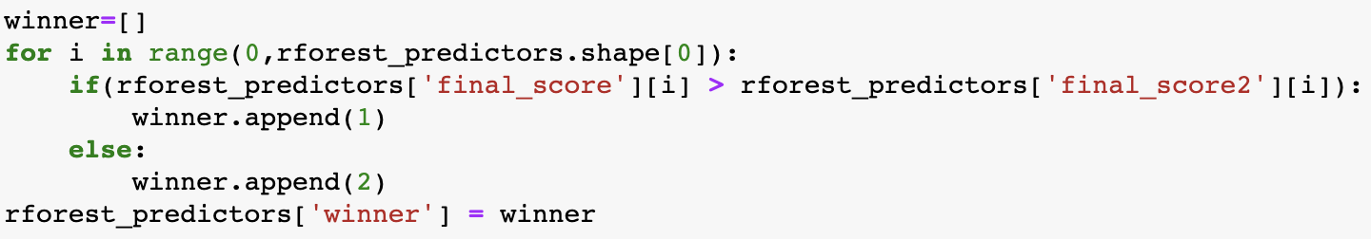
Random Forest Classification
Random forest is a Supervised Machine Learning Algorithm that is used widely in Classification and Regression problems. It builds decision trees on different samples and takes their majority vote for classification and average in case of regression
Refined our test train data to combine both innings of a match into one record, appending the required variables and removing extra columns
Used the Random Forest Classifier in Scikit Learn to obtain a boolean value as the prediction for the winner of each match

Slide 26
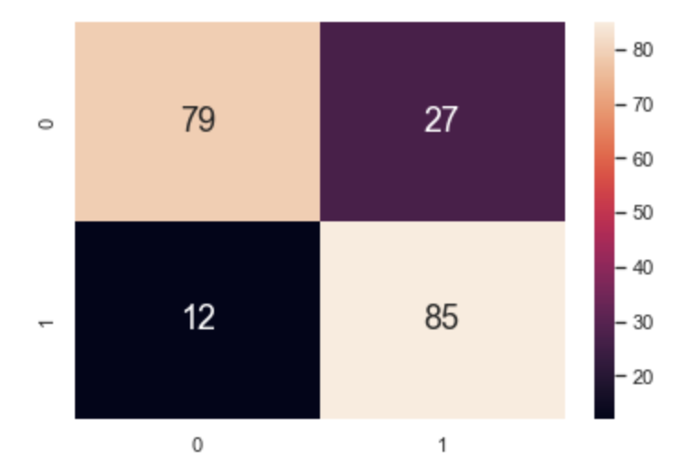
Outcome
Test Data:
True Positivity Rate Test : 0.877
True Negativity Rate Test : 0.745
False Positivity Rate Test : 0.255
False Negativity Rate Test : 0.124
Accuracy : 80.8%
Confusion matrix

Slide 27
Comparison
We found that the Random Forest classification Model was more accurate than the Multivariate Linear Regression model
The classification model predicted a class, whereas regression model predicted a numeric value, on the basis of which a winner was calculated. Hence the regression model is more susceptible to error
Linear regression is more suited to data that is linear in shape whereas random forest by the means of decision trees capture non-linearity better.

Slide 28
Conclusion
The final scores of many innings were predicted accurately by the linear regression model, even though cricket is such an unpredictable game.
With data from only 850 matches, the models were able to achieve good accuracy. By increasing the sample size, accuracy could be increased further
Including other predictors such as the historical data of players and home team advantage metrics.
An improved version could potentially replace the current projected score metric used in the IPL.

Slide 29
Thank You!

